Slide 1

Sprocket Central Pty Ltd
Data analytics approach
Omkar Bulland - [Data Analyst]
KPMG

Slide 2
Agenda
Introduction
Data Exploration
Model Development
Interpretation

Slide 3
Identify & Recommending High Value Customers
Introduction
Outline of Problems
Sprocket Central is a company that specializes in high quality bike & accesories.
The Marketing team is looking to boost Sales.
To target 1000 new customers that will bring the highest value to the business.
Approach for Data Analysis
Bike related Purchases for the last 3 years based on Gender
Top Industries contributing the maximum profit and bike sales.
Wealth segment by age category
Number of Cars owned in each state
Customer Classification

Slide 4
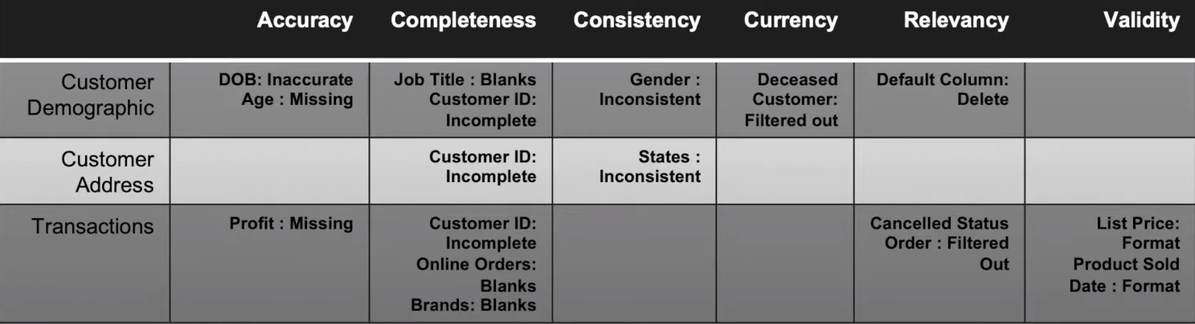
Data Exploration
Data Quality Assesment
Key Issue dealt with for the Data Quality issue.

Slide 5
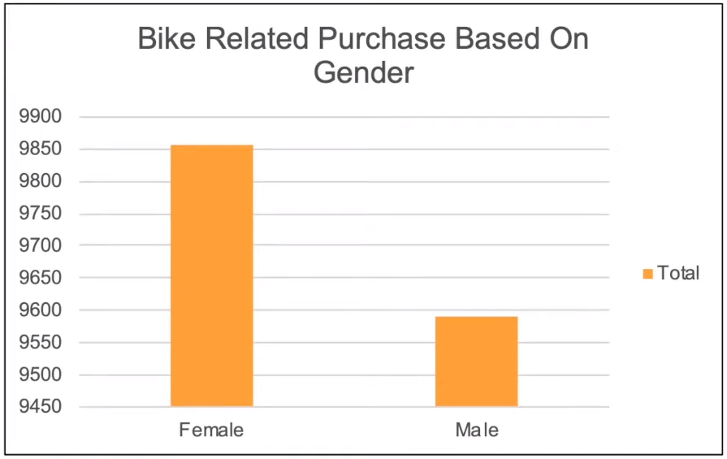
Data Exploration
Bike Related Purchases Over the last 3 Years based on Gender
Data shows, on average females have made more bike related purchases in last 3 years compared to males.
On Average Females have had 1% higher bike related purchases compared to men in the last 3 years

Slide 6
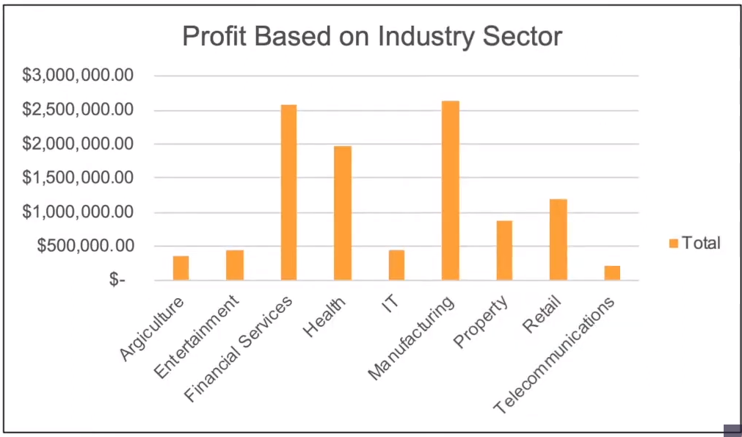
Data Exploration
Bike Top Job Industry Contributing to the Maxing Profit & Bike related
Key The Top 3 Industry Sector Bringing in the highest Profits are: Financial Services, Health & Manufacturing
These can be obvious as most of the Industry sectors are based within the City therefore consumers prefer Bike for commuting.
Most of the Industry Sectors have returned less than $1,000,000 in Profits

Slide 7
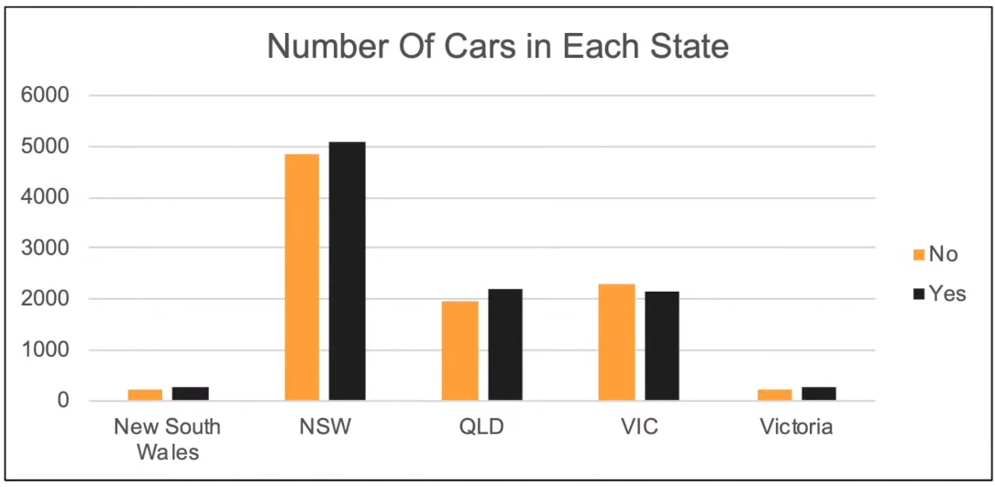
Data Exploration
Number of Cars Owned in each State
NSW, QLD & VIC could be potential market opportunities for the company.
NSW, has the highest potential as the number of people that owns car is almost equal to the people who don’t own cars which shows that there is opportunity to find value customers there.

Slide 8
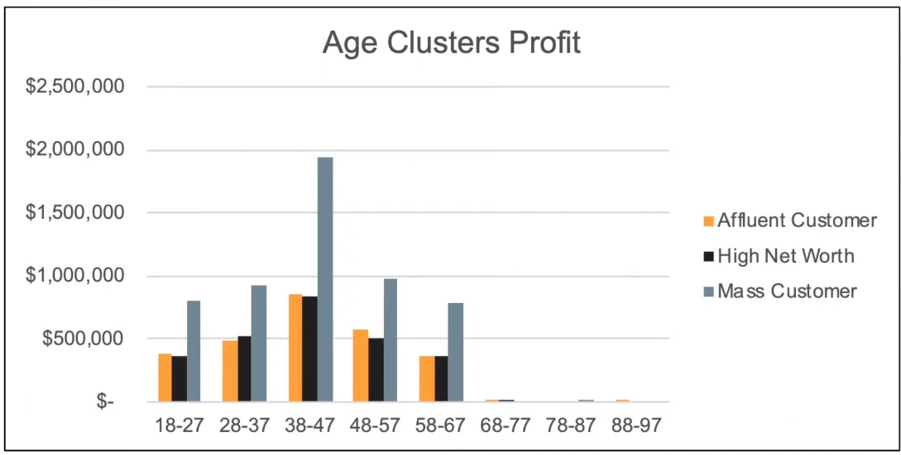
Data Exploration
Profit of Wealth Segment by Age Cluster
Overall the Mass customer segmentation makes the highest profit across different age clusters.
Mass Customer Aged between 38-47 are likely to bring more profit for the company compared to other age clusters
This also indicates a trend of buying power as the buying power increases over time till age 47 and then see’s a decline in buying power thus leading to lower Profits

Slide 9
Model Development
Customer Classification - Targeting High Value Customers
There are the high value customers that should be targeted from the new list:
Most of the high value customers will be Female compared to Male
Working in the Financial services, Health & Manufacturing industry sector
Aged between 38-47
Who are currently living in NSW, VIC

Slide 10
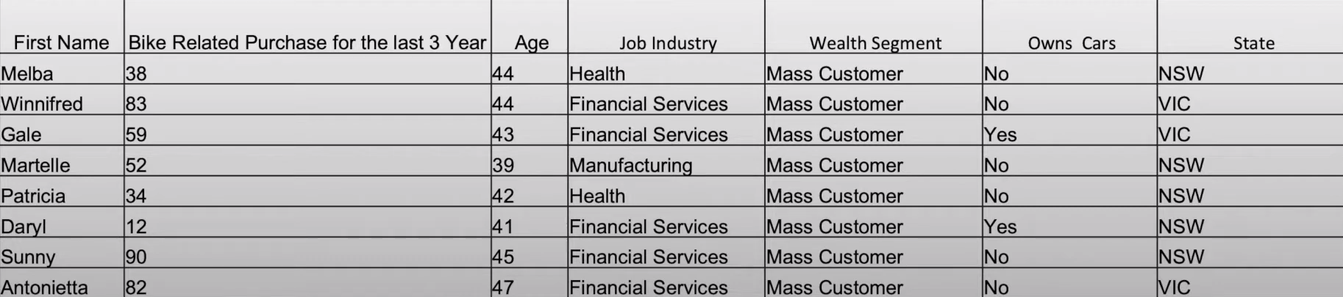
Interpretation
Summary Table for High Value Customers
Here is a snapshot of a few customers that will come under the High Value Customer Classification

Slide 11
Note: The data and information in this document is reflective of a hypothetical situation and client. This document is to be used for KPMG Virtual Internship purposes only.
Thank You

